Slide 1
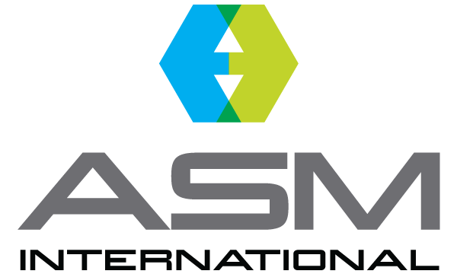
ASM International Residual Stress Technical Committee
Why Join the ASM RSTC?
Stay up to date on the latest developments in the measurement and analysis of residual stress - the RSTC meets on a monthly basis.
Network with other professionals in both industry and academia who focus on the measurement and analysis of residual stress.
Activities include: Industry Standards, Residual Stress Handbook, Newsletter, Education and Chapter Outreach, Professional Meetings, Conferences, Symposia, University Outreach, Technical topic presentations, and more…
You don’t need to be an ASM member to join the committee meetings and benefit from them - get involved today!
Not sure? Contact beth.snipes@tec-materialstesting.com for more information.

